Slide 1
TrainUP
Online Meeting
Lesson 01 – Simple Present
Daily Routine

Slide 2
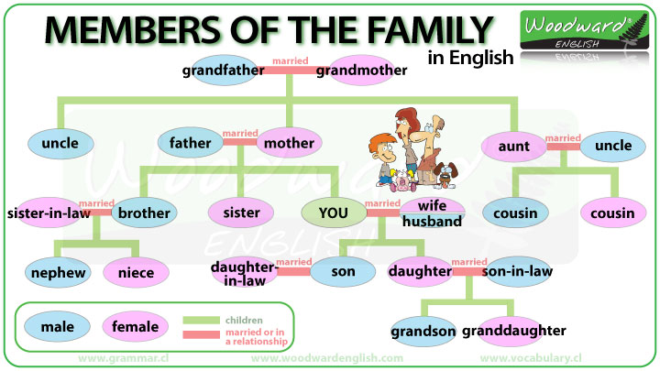

daily routine

Slide 3
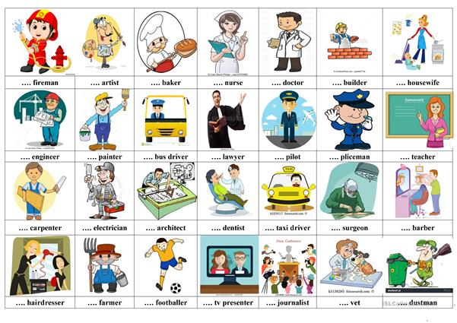
daily routine

Slide 4
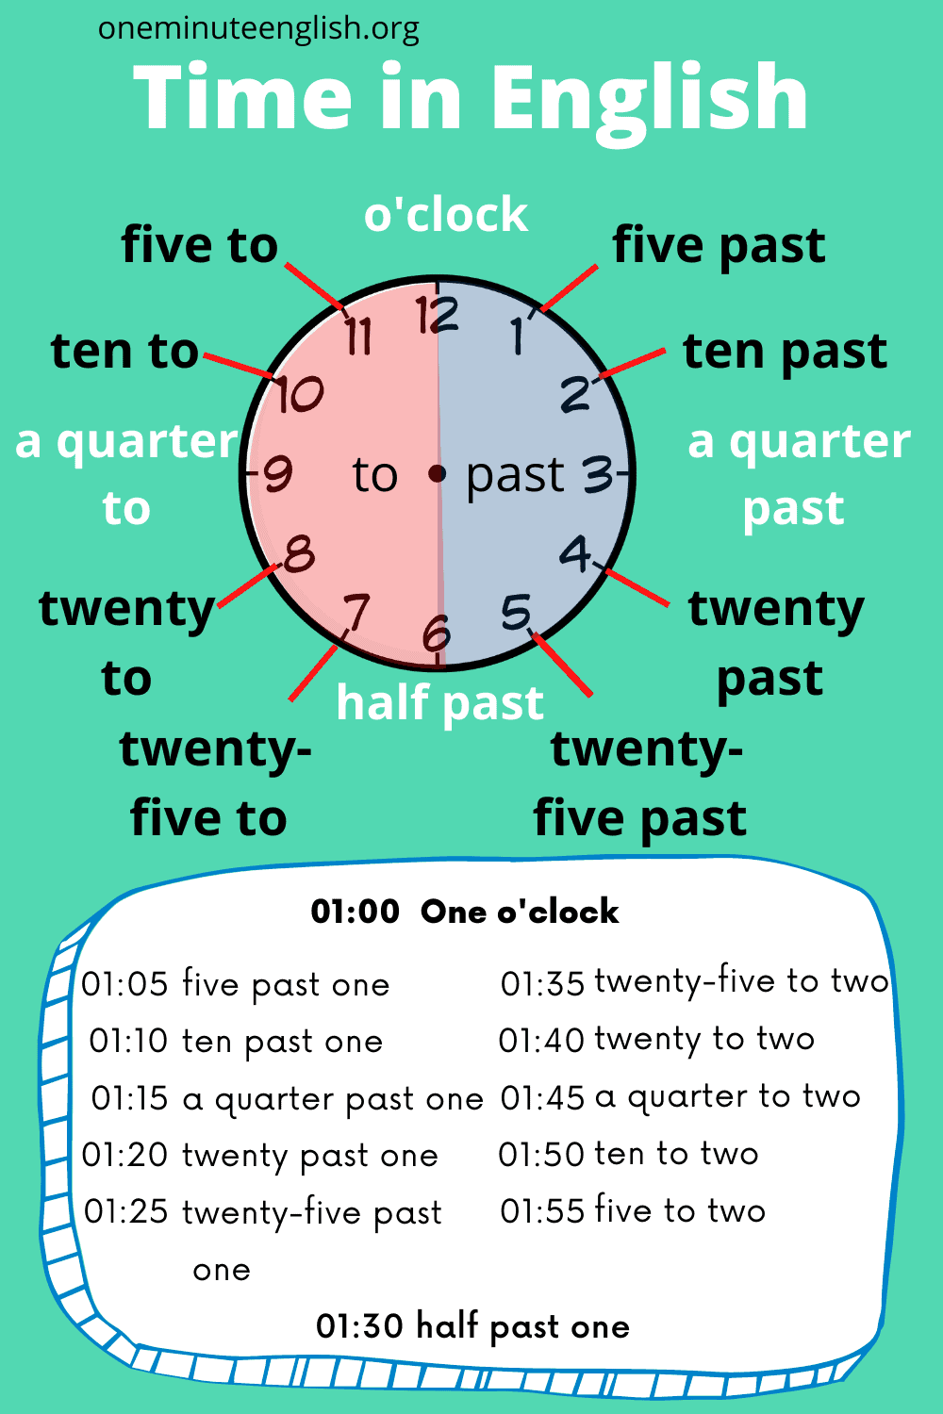
daily routine

Slide 5
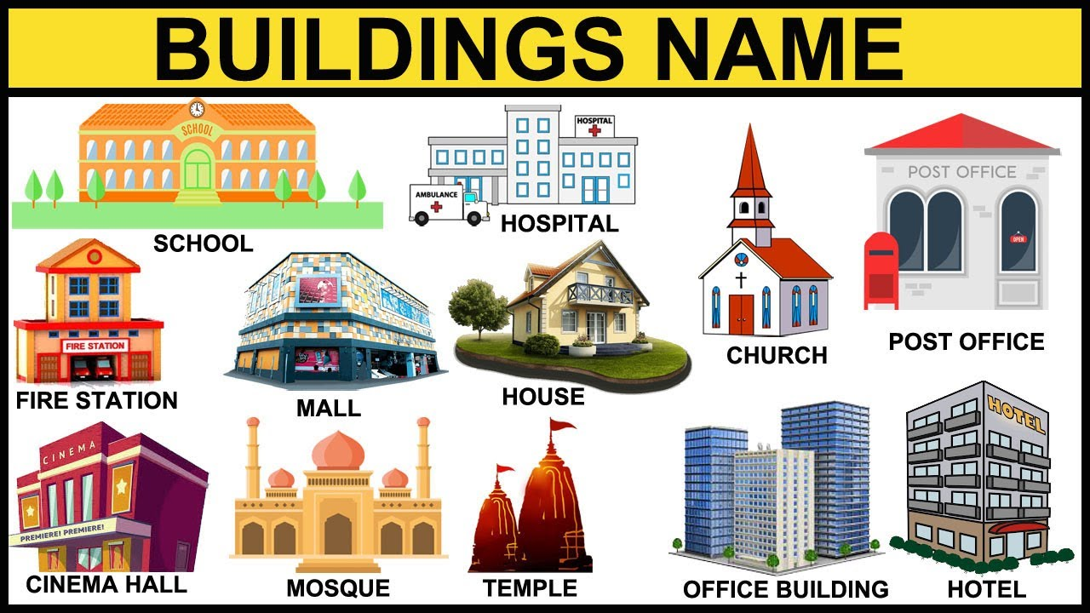
daily routine

Slide 6
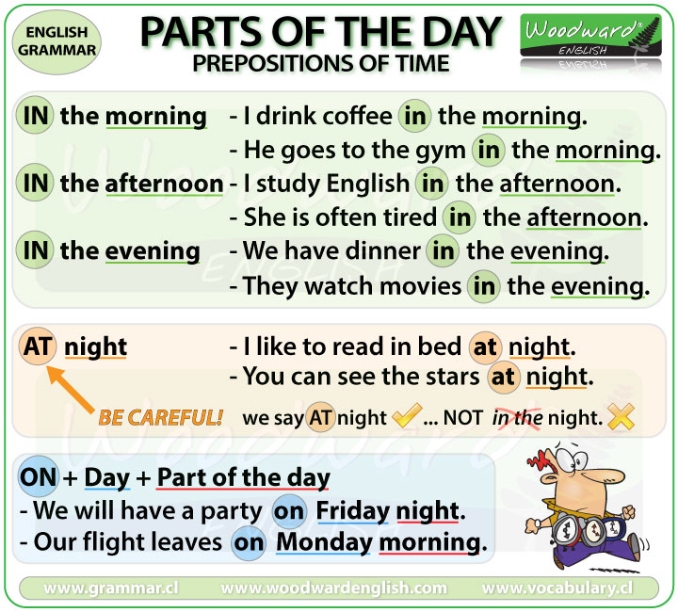
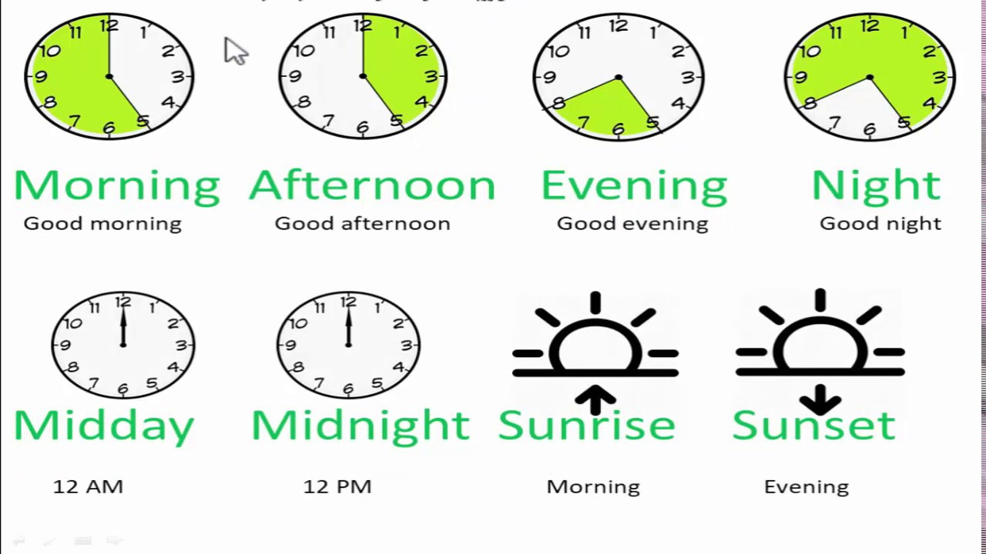
2 – daily routine

Slide 7
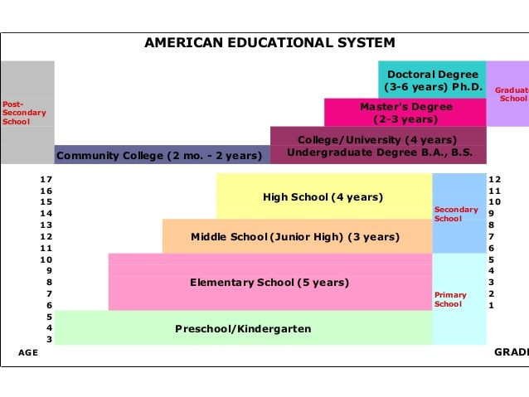
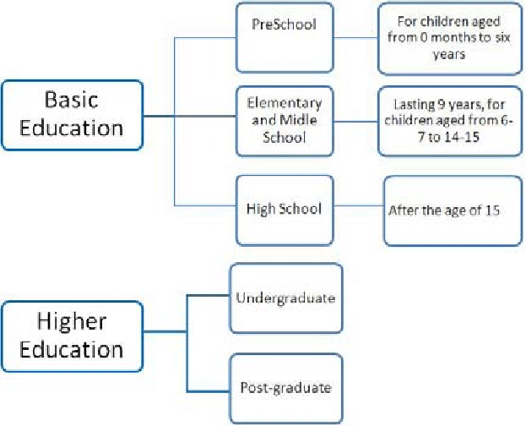
2 – daily routine

Slide 8
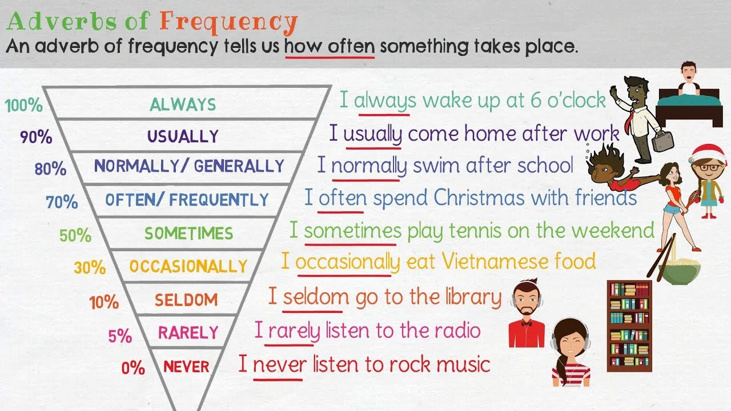
2 – daily routine

Slide 9


TrainUP
Online Meeting
Lesson 01 – Simple Present

